Slide 1
Yield Farming

Slide 2
01
Introduction

Slide 3
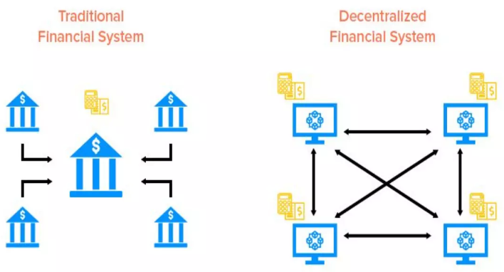
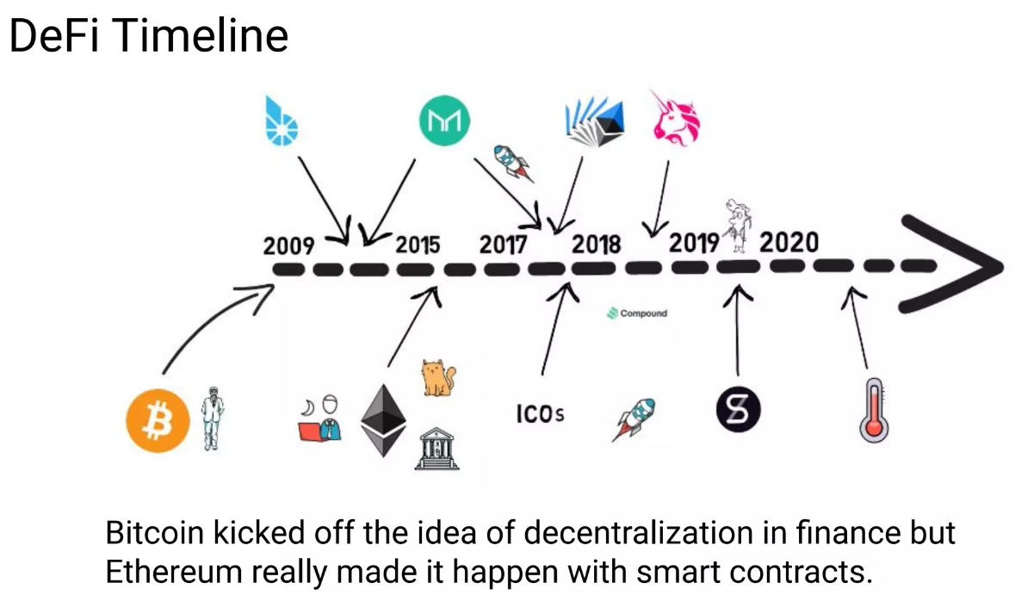
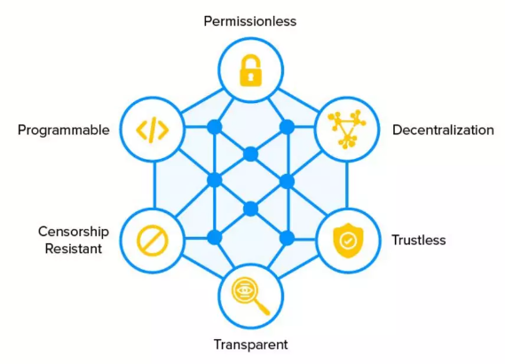
DeFi :
Open and Global financial system on public blockchains, accessible to anyone with an internet connection.
Peer - to - Peer, doesn’t rely on intermediaries. Pseudonymous

Slide 4
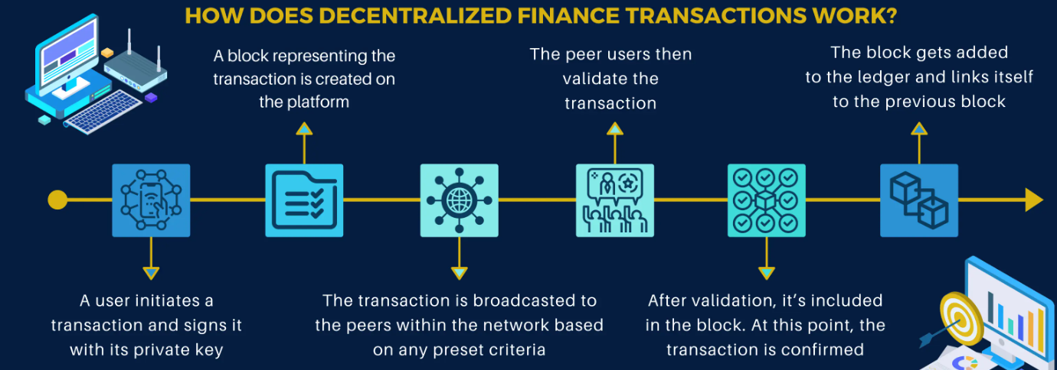
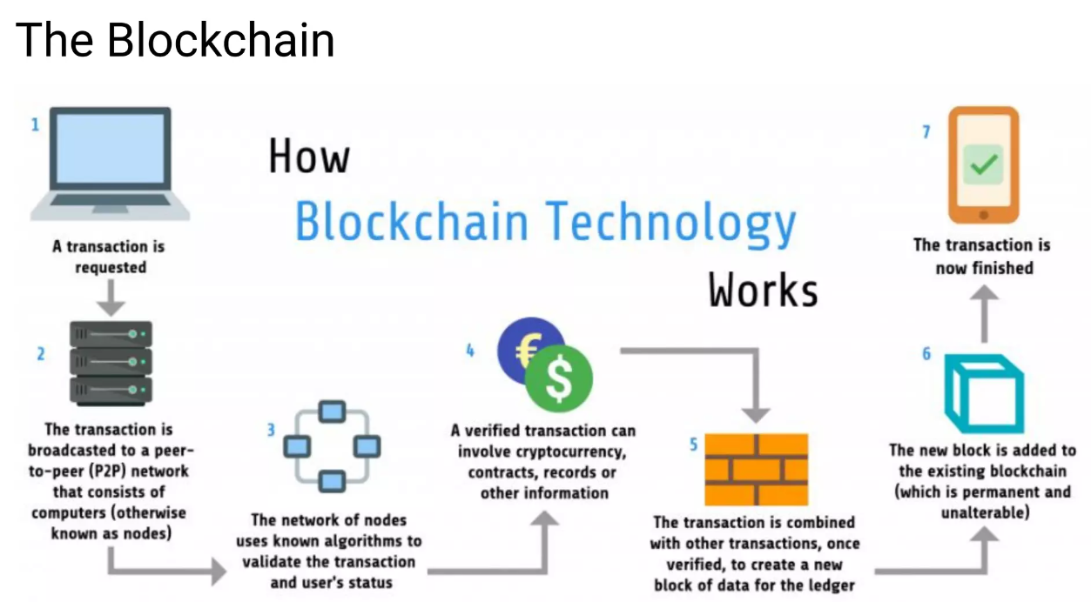
How does DeFi work :
Defi uses blockchain technology where users typically engage with it via DApps(Decentralized Applications). Most of DApps run on Ethereum Blockchain.

Slide 5
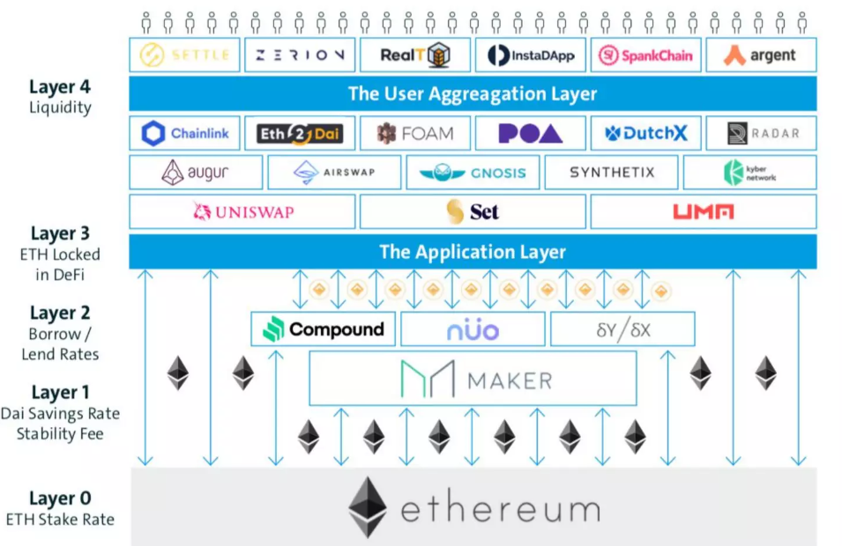
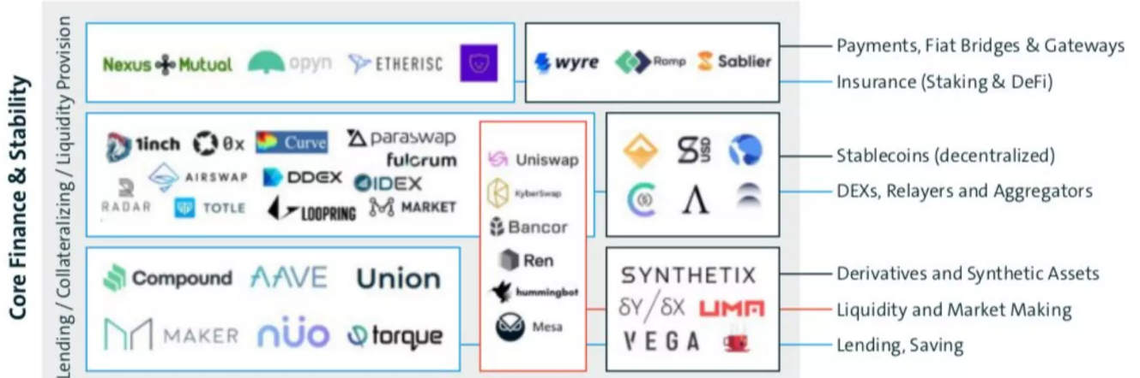
What can be done with Defi?
Lend, Borrow, Trade, earn returns through Yield Farming

Slide 6
DeFi has gained significant traction during the past years. To measure the health of DeFi an index, TVL(Total Value Locked) is used. TVL indicates the amount of funds that are held by smart contracts related to DeFi protocols.
2020
Mar
2021
Sept
2022
April
600 Million USD
120 Billion USD
160 Billion USD

Slide 7
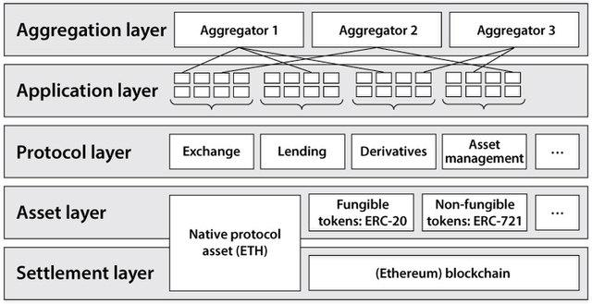
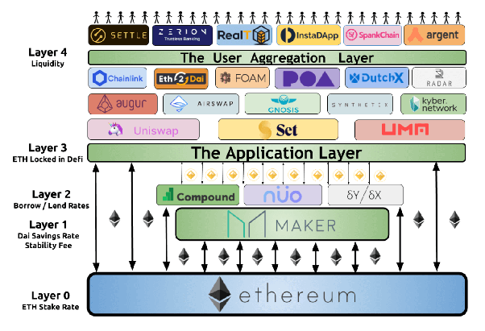
The permissionless nature and the openly auditable protocols, a main driver for the growth of this industry is the composability of financial services. The so-called “DeFi Stack” or “Money Legos” allow protocols to build and combine functionalities, without the need of having this expertise in-house. This means that developers can focus on the core business, knowing that key infrastructure and money legos like decentralized exchanges, lending markets and yield services, are readily available to plug in.

Slide 8

One of the applications that has come from the above described movement is “Yield Farming”.
YIELD FARMING
It is a method where investors passively earn interest/yield by transferring tokens(cryptocurrencies) to a wide range of yield generating smart contracts. It is the practise of staking or lending crypto assets to generate high returns or rewards in form of other cryptos.

Slide 9
02
Fundamentals of Yield Farming

Slide 10
What is Yield Farming ?
Yield Farming, also referred to as Liquidity mining. Liquidity mining is a method of incentivizing people to provide liquidity to a market or a platform by rewarding them with tokens or other incentives. It is a way of attracting more users to a platform and increasing the liquidity of the market. In a liquidity mining program, users can earn rewards by providing liquidity to a market or platform by buying and selling assets, or by simply holding assets in a liquidity pool. The rewards are typically distributed in the form of tokens, which can be traded or used on the platform.
Yield Farming can also be paralleled with staking. Yield farming is typically done using ERC-20 tokens on Ethereum, and the rewards are usually also a type of ERC-20 token.

Slide 11
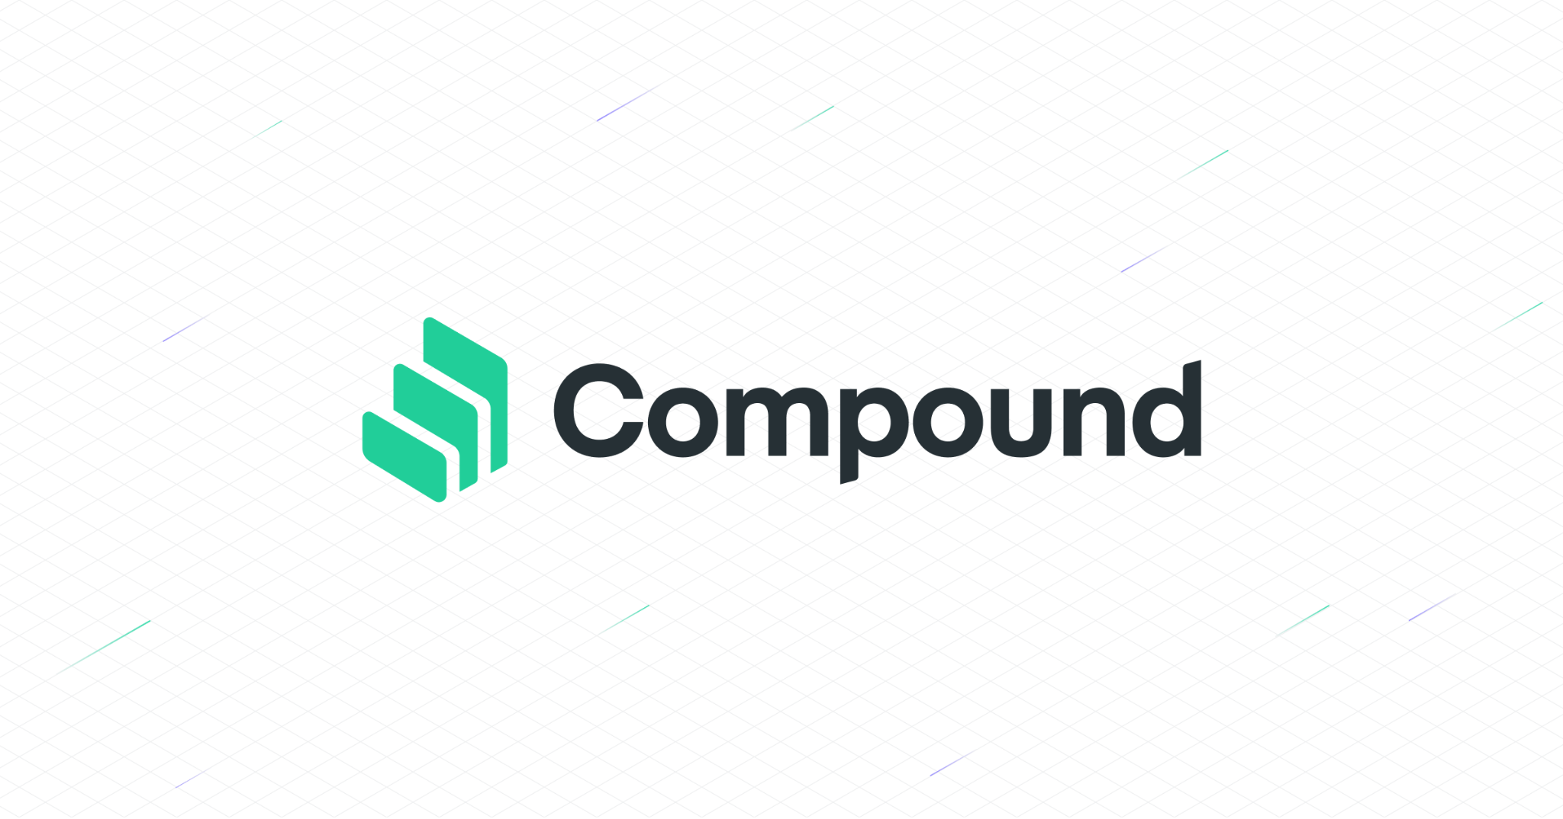

What made yield farming boom?
Yield Farming started to gain traction since introduction of COMP,the governance token of Compound, a major DeFi lending protocol. Compound participants - liquidity providers, get rewarded with newly minted COMP tokens through both lending and borrowing activities.
The basic yield farming idea was born: the search for opportunities in the DeFi ecosystem to generate returns on otherwise idly-sitting crypto assets. As a reaction to the creation of a multitude of platforms returning interests, fees and token rewards, yield aggregators built on top of the DeFi primitives came into existence.

Slide 12
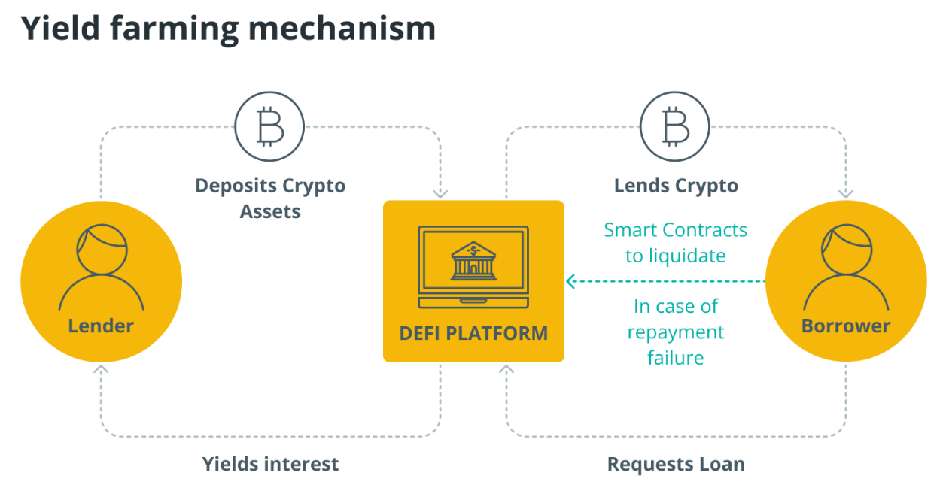
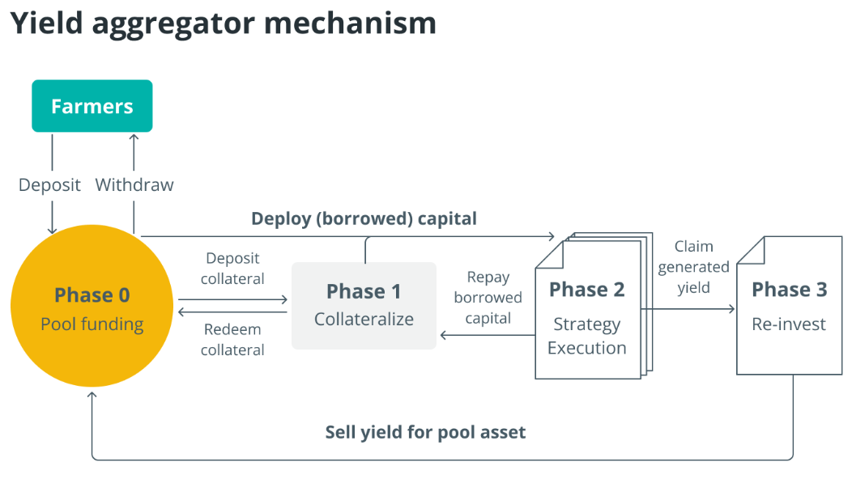
A yield aggregator is a set of smart contracts (called a “protocol”) that pools investors’ funds, and invests them in an array of yield-producing products or services through interacting with their respective protocols. The process of generating yield on crypto assets is termed “yield farming”, and yield aggregator users are thus also known as “yield farmers”. In essence, a yield aggregator can be deemed as a smart contract-based fund manager, whose investment strategies are pre-programmed and automatically executed

Slide 13
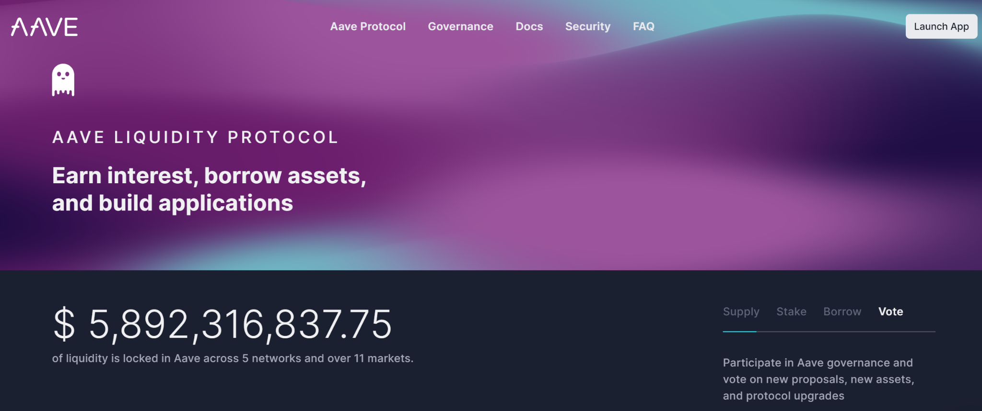
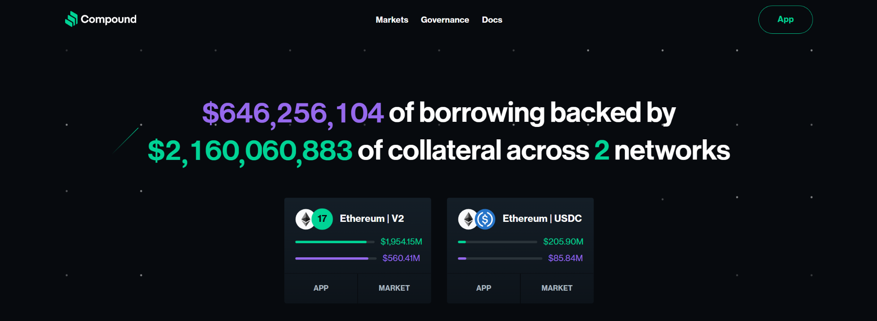
Protocols
Yield farming relies on other building blocks in the DeFi stack.
Lending Protocols: It enable lending and borrowing of on-chain assets, with the interest rate set programmatically by a smart contract. On these platforms, funds are pooled together to be borrowed by other users that want to take out a loan in a specific asset. Suppliers of loanable funds receive interest over time, borrowers pay interest.
Ex. Aave, Compound

Slide 14
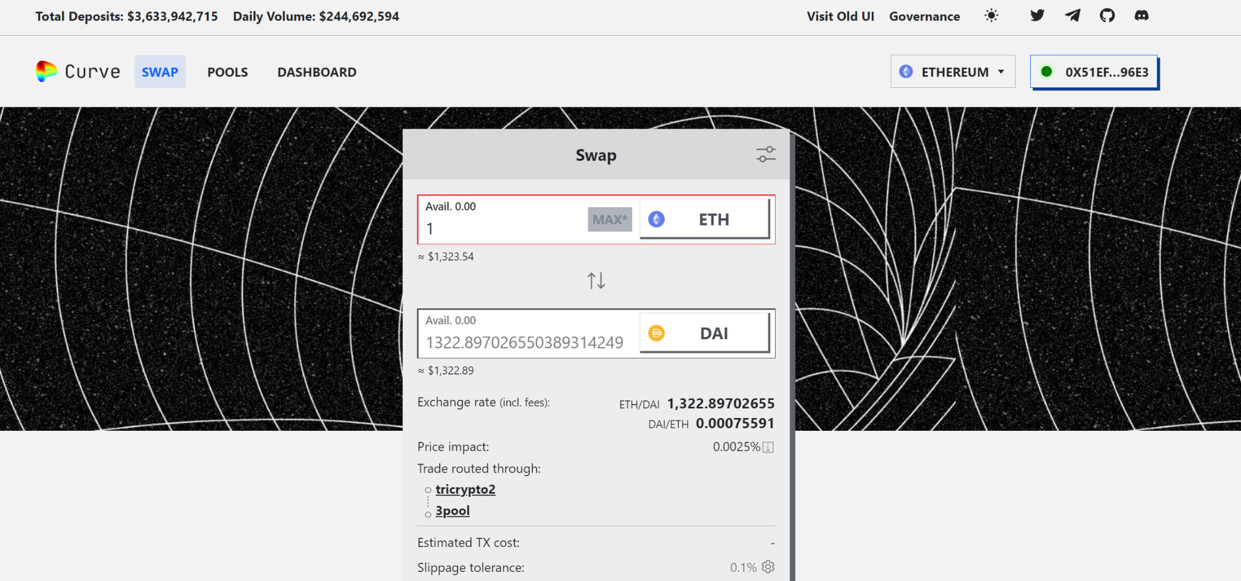
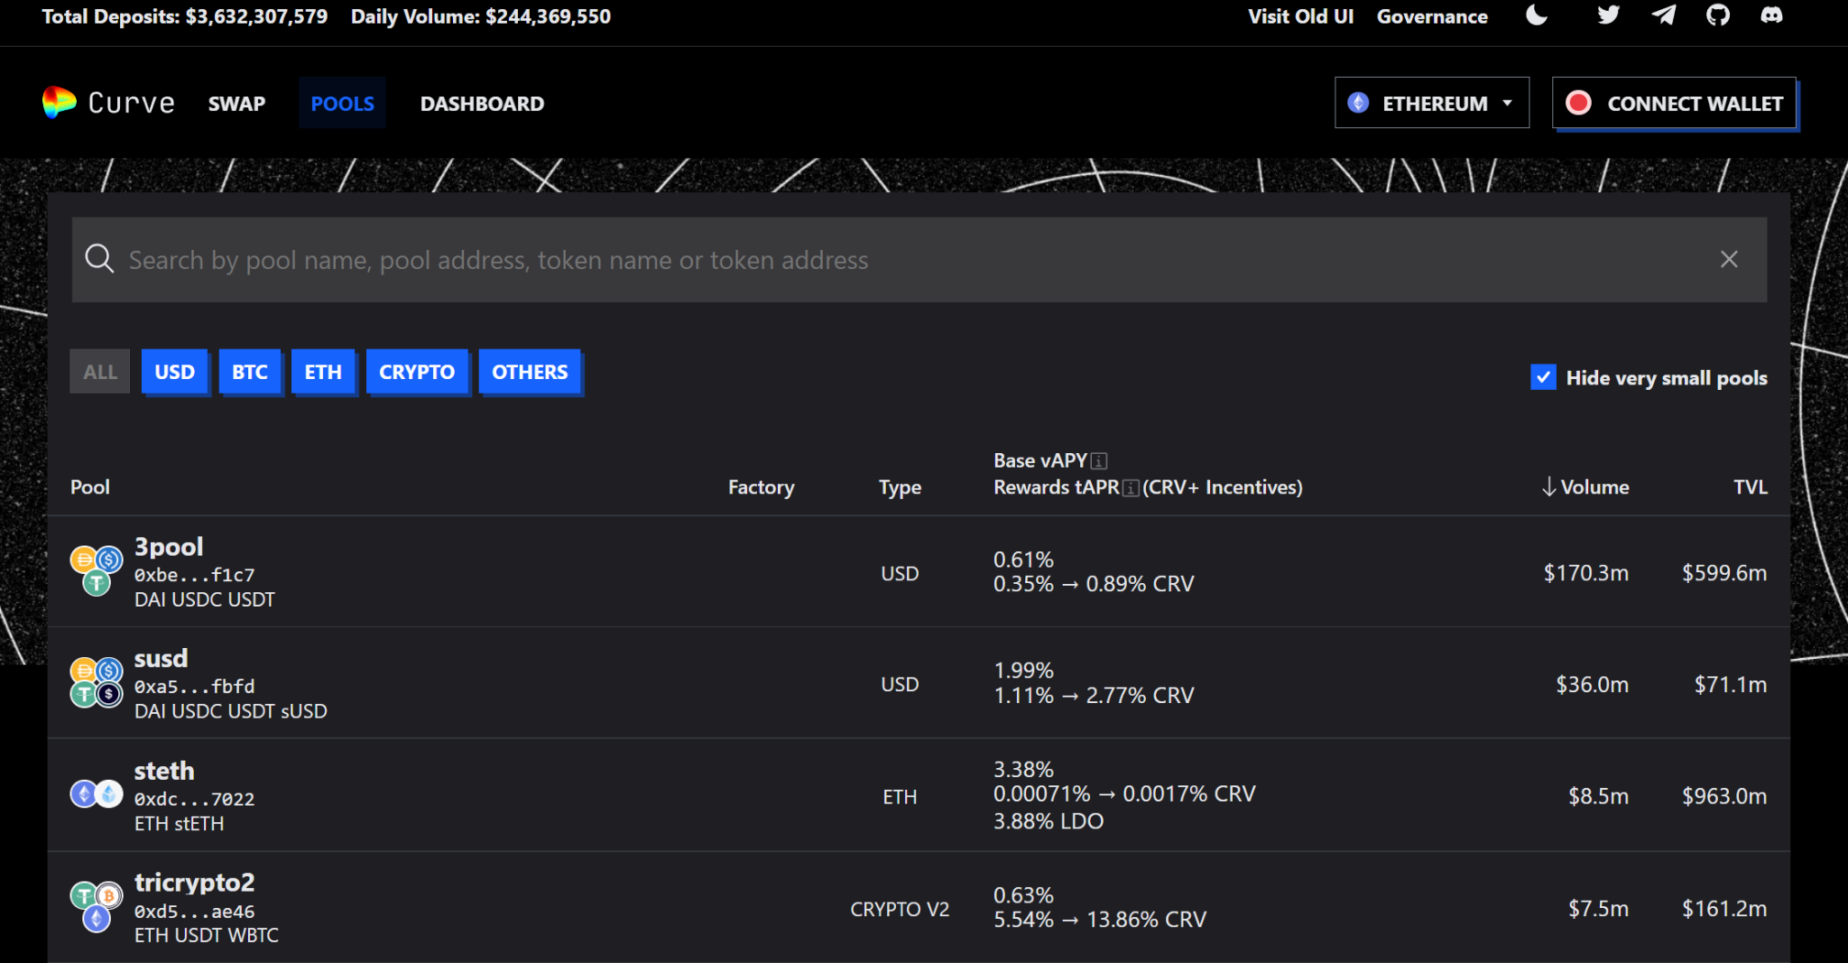
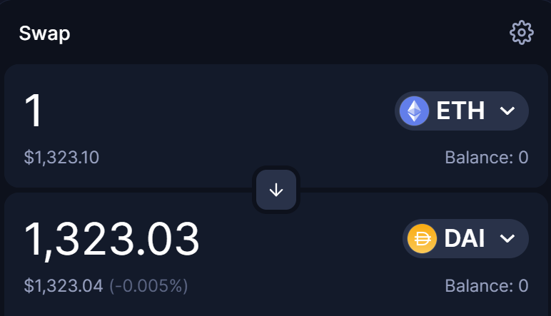
2. Automated Market Makers (AMM): AMMs provide liquidity algorithmically by pooling funds and determining asset prices via a so-called conservation function. In a liquidity pool, reserves of two or more assets are locked into a smart contract. There are two core actors involved in the general mechanism of AMMs. First, there are the liquidity providers, who add funds to the asset pool. In return, they receive liquidity provider (LP) tokens proportionate to their liquidity contribution as a fraction of the entire pool. Generally, these LP tokens can be redeemed anytime the liquidity provider wants to get his funds back. The second core actors are the traders, who swap an input asset (what to be spent) for an output asset (what to be received). The exchange rate between the assets is deterministic, depending on the size of the pool and the desired amount to be traded.
Ex. Uniswap, Curve

Slide 15
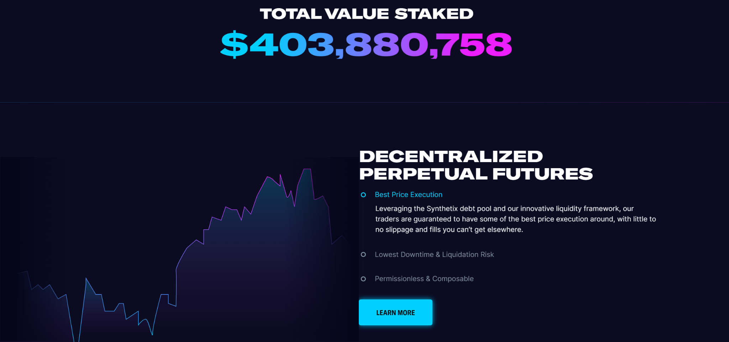
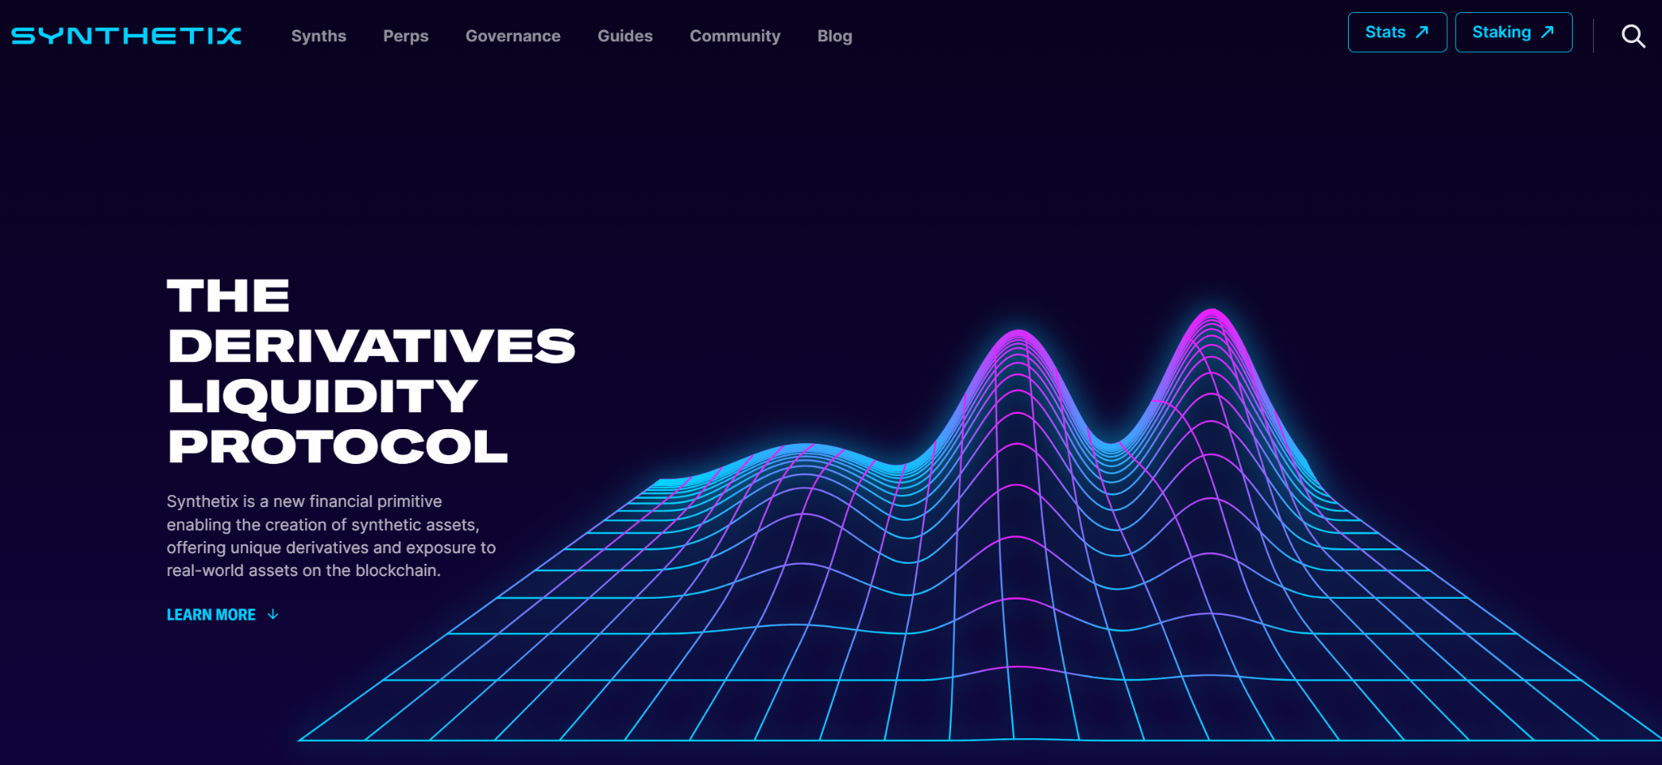
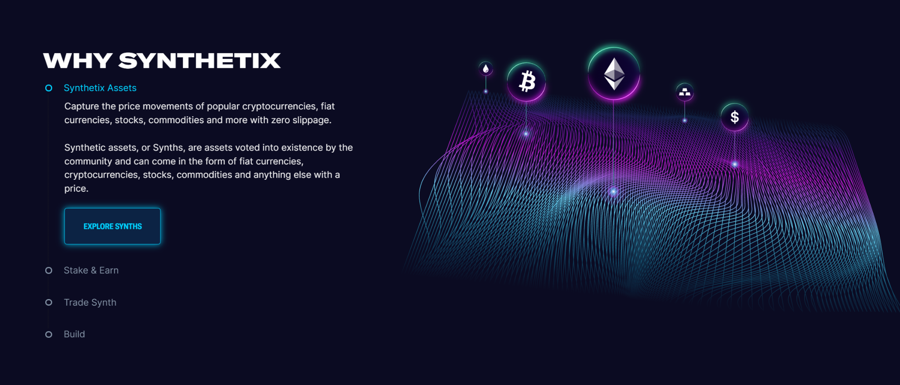
3) Others: Next to lending platforms and AMMs, which are the backbone of DeFi, other protocols can offer yield in their own way. This can be through the products they offer, or through liquidity mining programs. Examples of yield offering products that are neither lending platforms, nor AMMs, are Synthetix.

Slide 16
Tokens
Token - is just another name for cryptocurrency. A token is a digital asset that is built on top of another blockchain. Tokens are typically created as part of an initial coin offering (ICO) or a security token offering (STO).
Stable Coins : Digital assets pegged to the value of a fiat currency or another asset, such as the U.S. dollar. Help reduce volatility and make them more useful for everyday transactions. Ex. Tether, USDC, and DAI.
Governance Token : token that represent the right to vote on decisions that affect the underlying protocol or platform. Ex. Ethereum, COMP
LP Tokens : AMM Liquidity Provider Token. Liquidity tokens are generated and delivered to the liquidity provider whenever liquidity is deposited into a pool.
Yield Tokens : Also called Lending platform interest-bearing tokens or Income Tokens
Ex. aTokens by AAve, cTokens by Compound
Exchange/Utility Tokens : Tokens that are used to provide access to a specific decentralized exchange (DEX) or centralized exchange (CEX) services and benefits. Ex. BNB

Slide 17
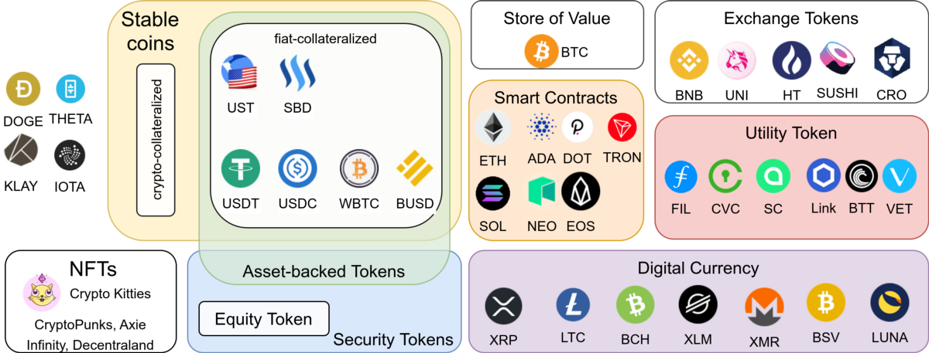
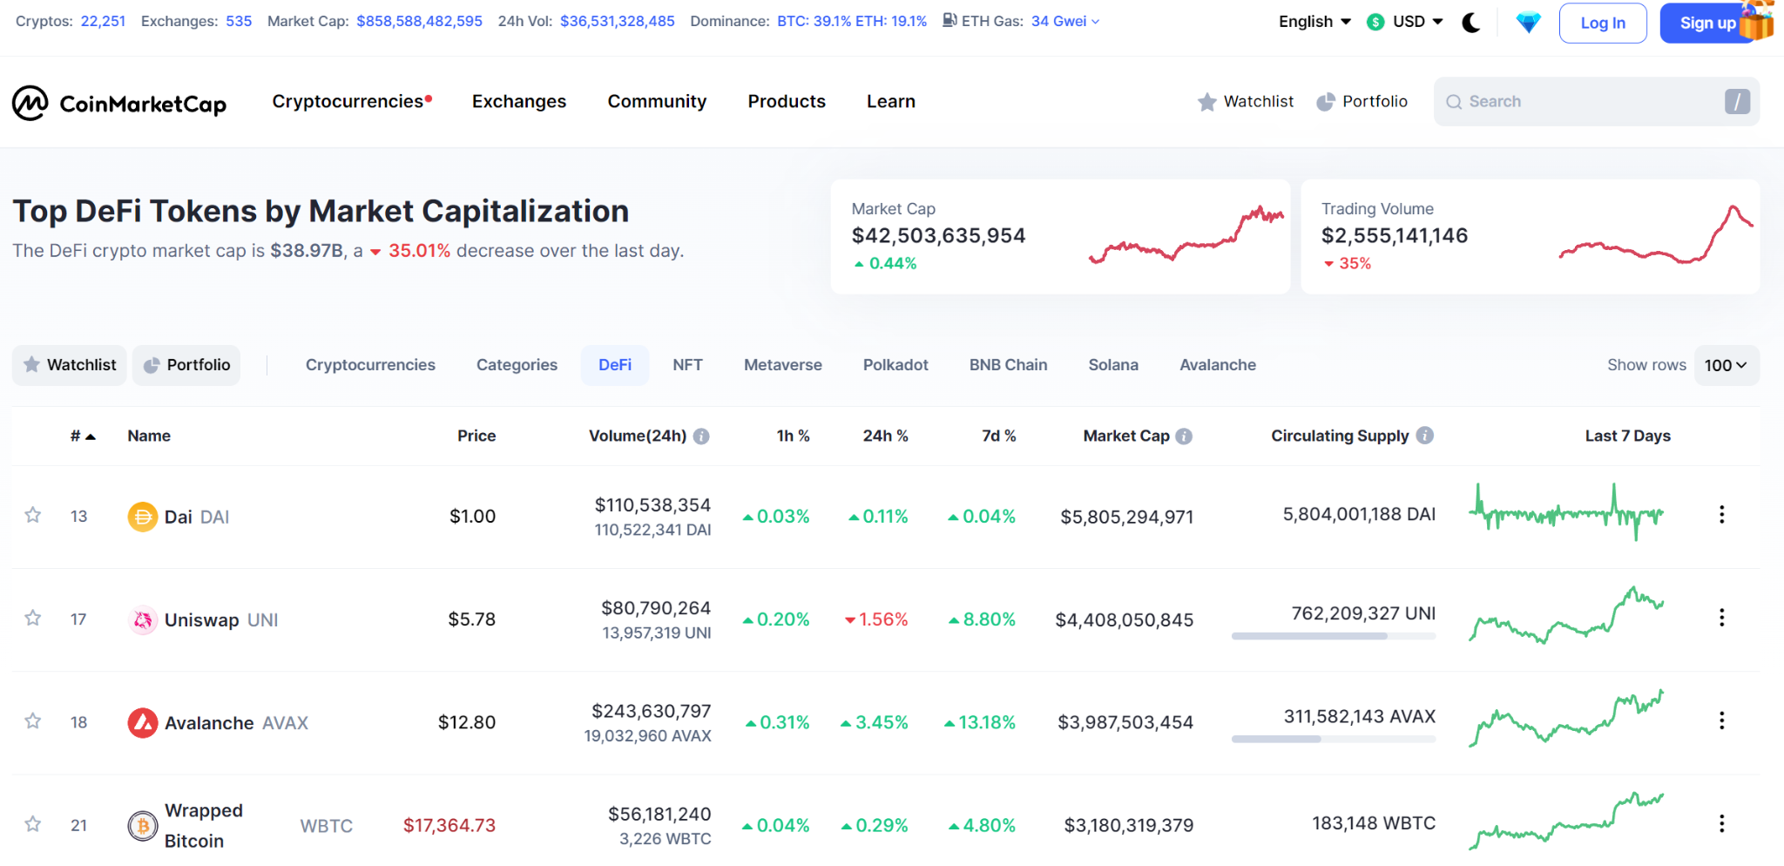
Yield : Defined as “the total amount of profit or income produced from a business or investment” , is often measured in terms of Annual Percentage Rate (APR) and Annual Percentage Yield (APY). The difference between them is that APR doesn’t take into account the effect of compounding, while APY does. It is the ultimate goal pursued by farmers, and typically originates from borrowing demand, liquidity mining and so.

Slide 18
1) Borrowing demand: As the demand for loans in crypto assets grows, the borrowing interest rate increases, leading to higher yields for lenders
2) Liquidity mining: Another yield source comes from liquidity mining programs, where early participants receive native tokens representing protocol ownership. This incentivizes people to contribute funds into the protocol, and enhances decentralization as the protocol ownership is distributed to users.
3) Revenue sharing: Some tokens entitle users to part of the revenue that is going through the protocol. These can be governance tokens or other kinds of tokens. One example is the liquidity provider tokens in AMM-based DEXs. By supplying liquidity into an AMM pool, users receive the fees that are paid by traders within that pool. The higher the volume in that pool, the more fees that are generated, and the more a liquidity provider profits from this

Slide 19
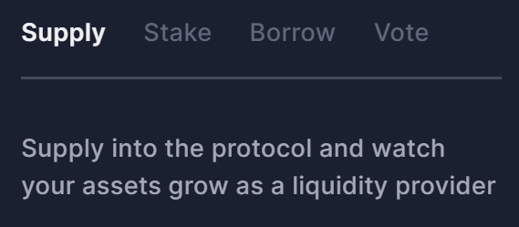
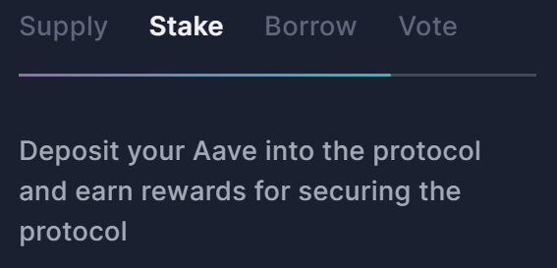
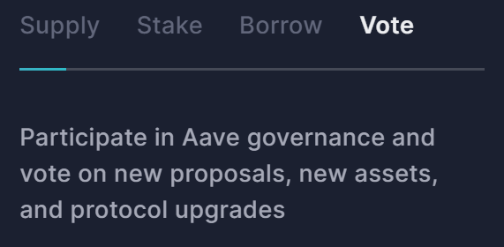
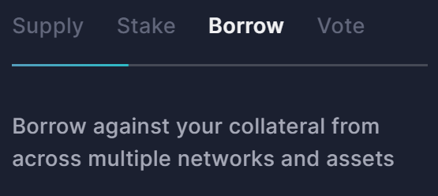
Yield Farming Platforms
Lending Platform : AAVE
A Decentralized lending and Borrowing platform on Ethereum Blockchain. The protocol allows users to stake, lend and borrow a wide variety of digital assets, including stablecoins, in a trustless and decentralized manner. AAVE's core functionality is based on the concept of liquidity pools. These pools are maintained by liquidity providers who deposit digital assets into them in exchange for an interest-bearing token called an "aToken" (Aave Token). Users can then borrow assets from these pools by providing collateral in the form of another asset.

Slide 20
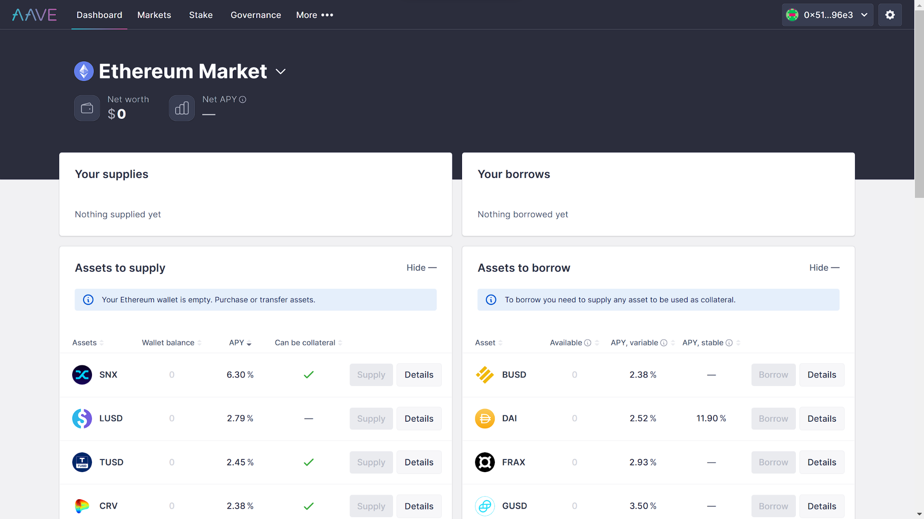
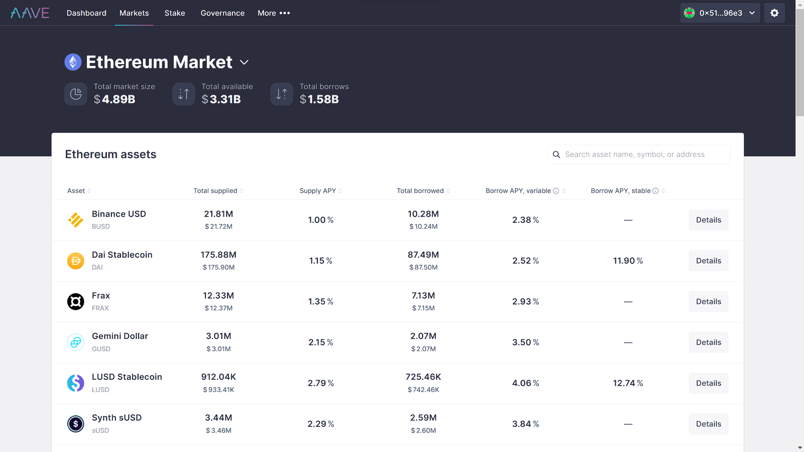
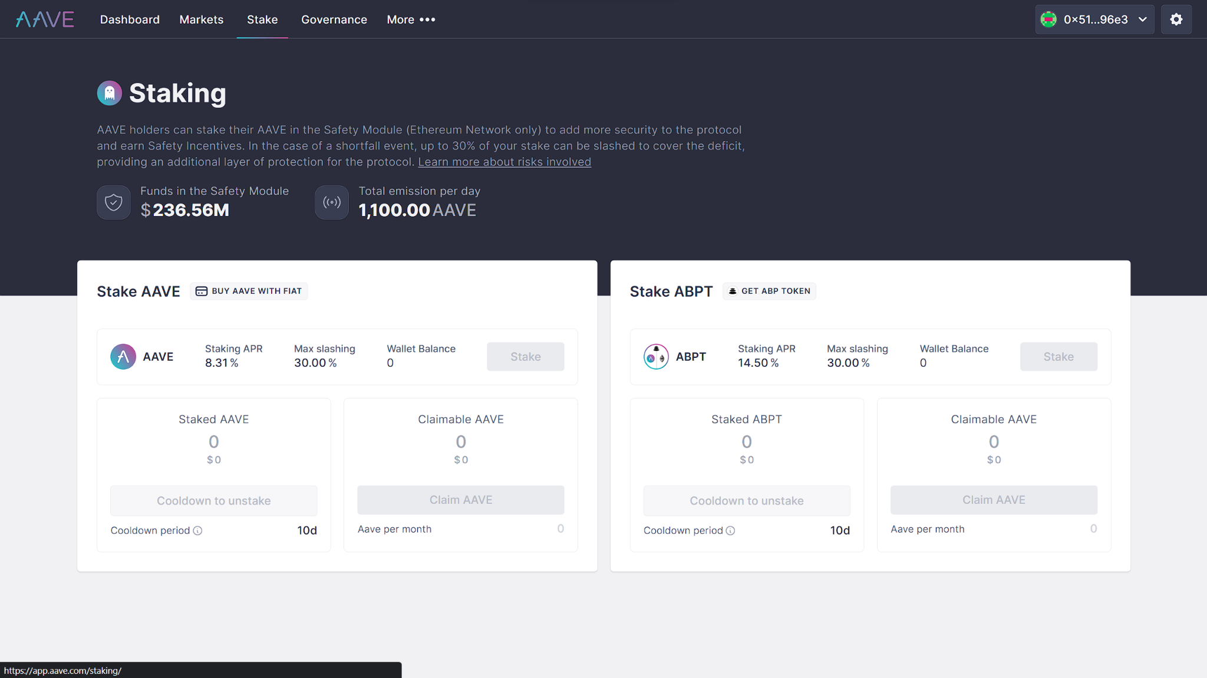
aToken represents a share of the liquidity provided to the pool, and it earns interest on the assets deposited into the pool. Users can borrow assets from the liquidity pool by providing collateral in the form of another asset. The collateral is locked up in a smart contract.The borrow interest rate on the platform is dynamic and determined by the collateralization ratio which means the amount of collateral to the borrowed value. If a borrower's collateralization ratio falls below a certain threshold, they will be required to deposit more collateral or their position will be liquidated.

Slide 21
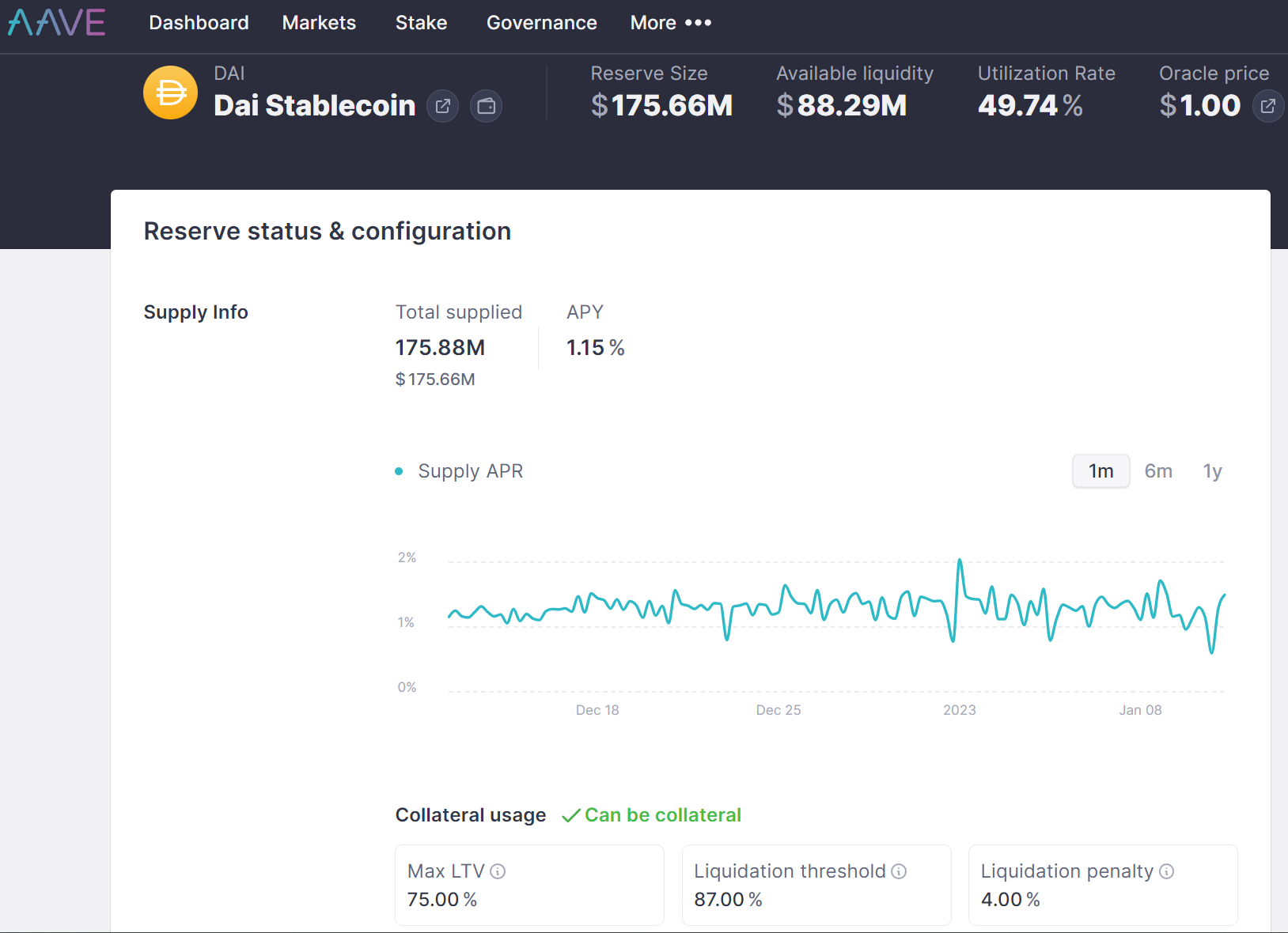
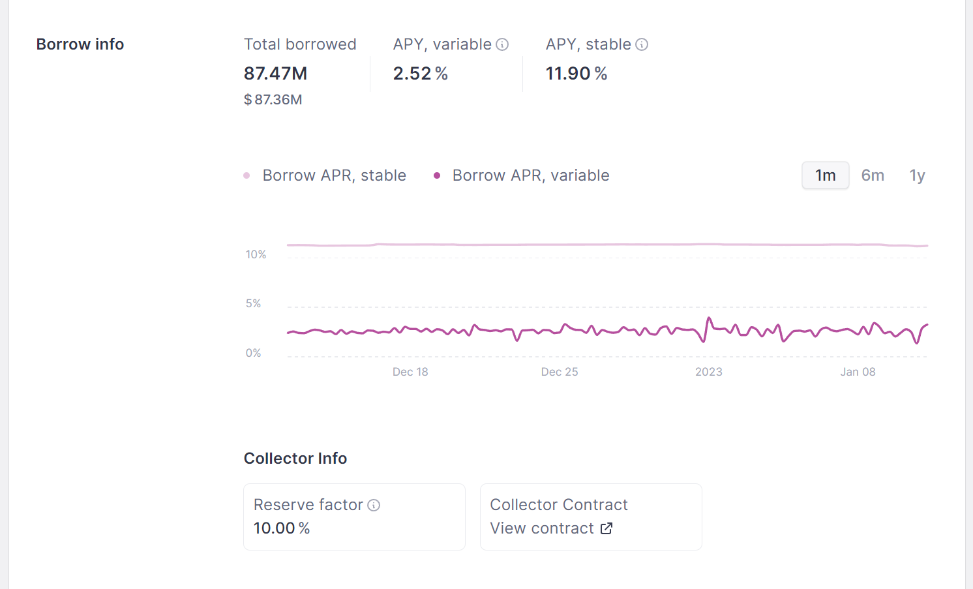
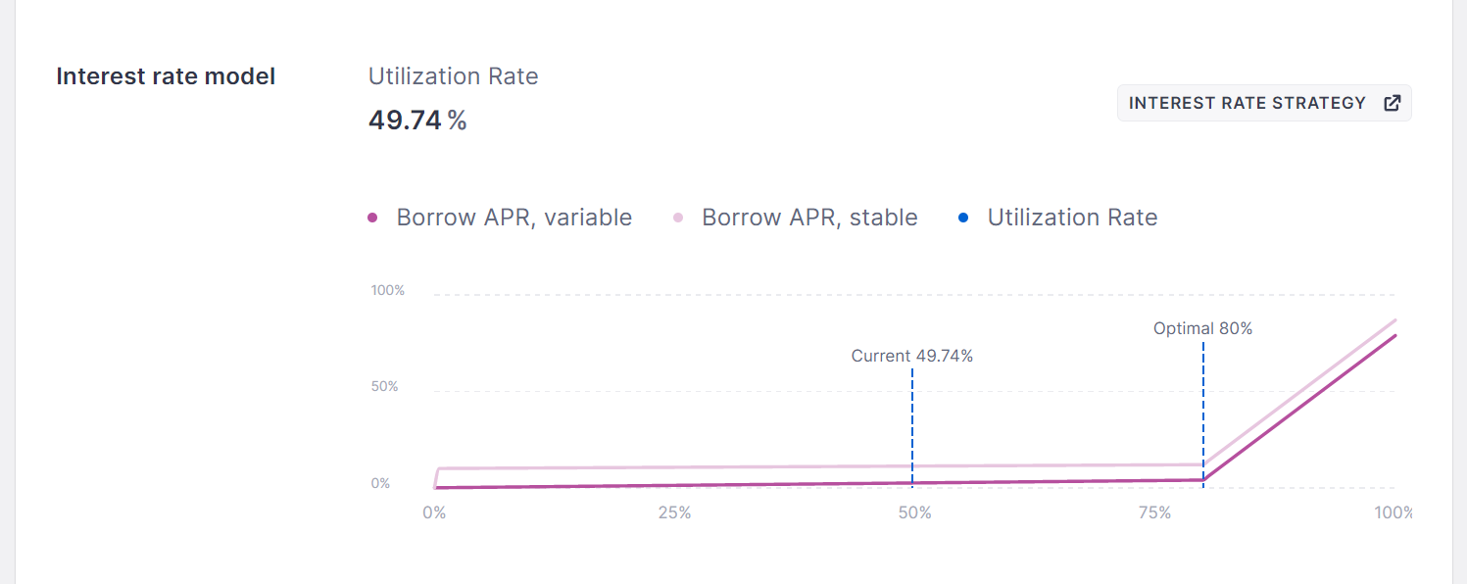

Slide 22
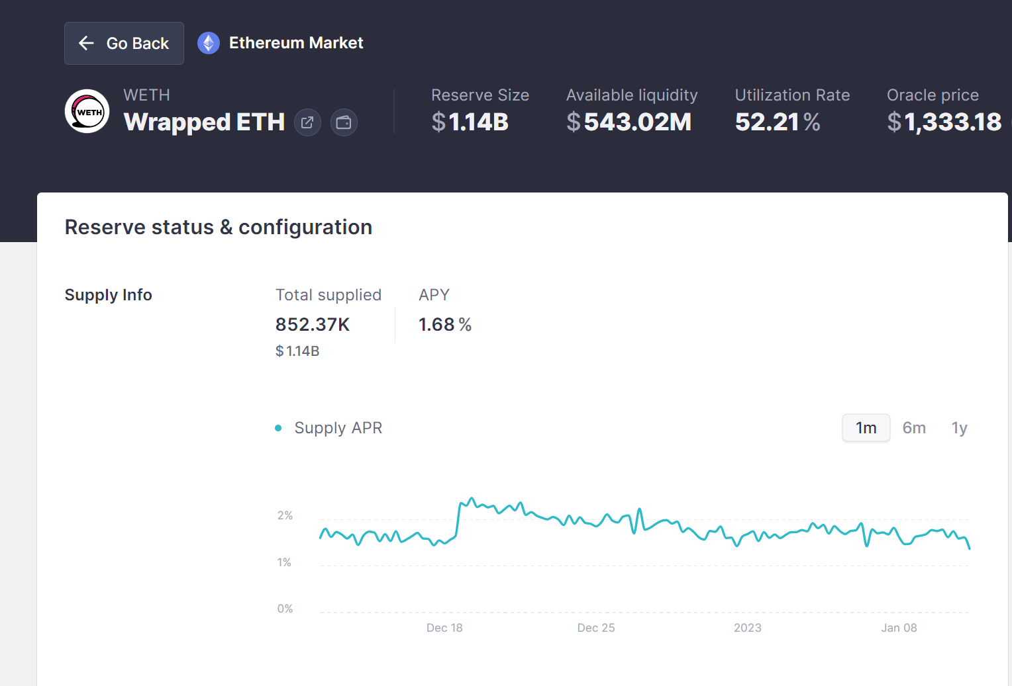
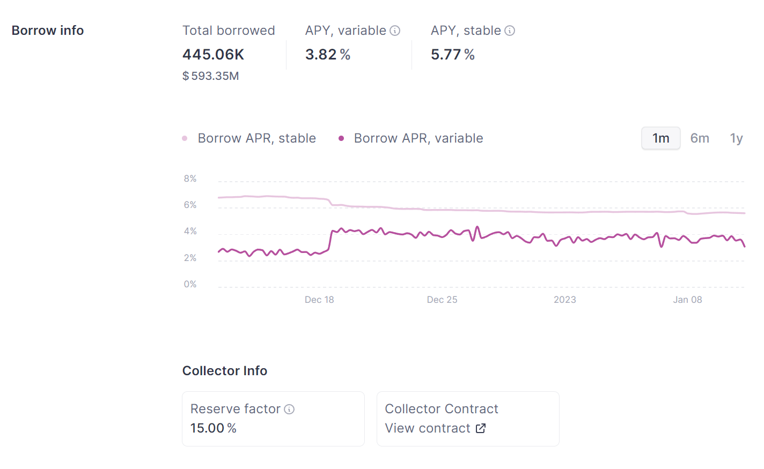
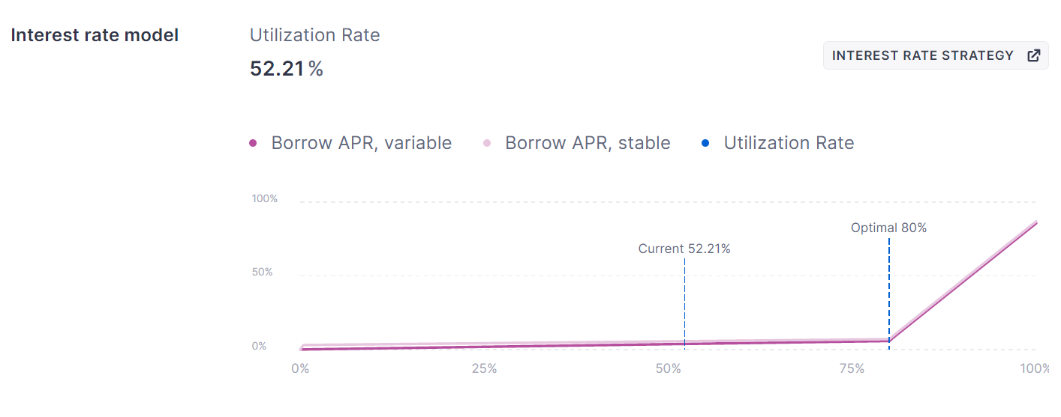

Slide 23
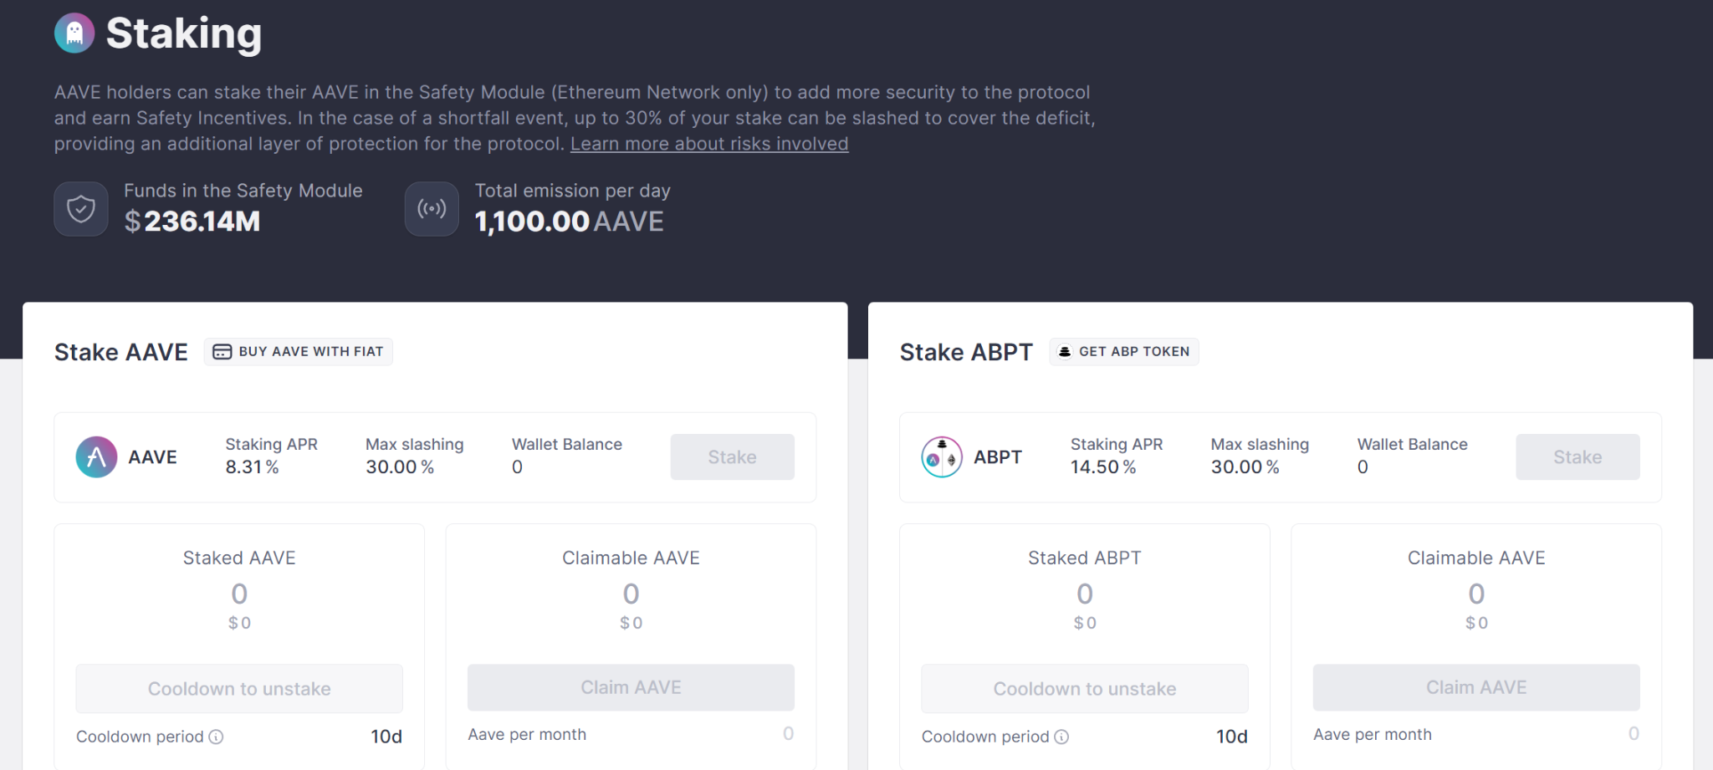
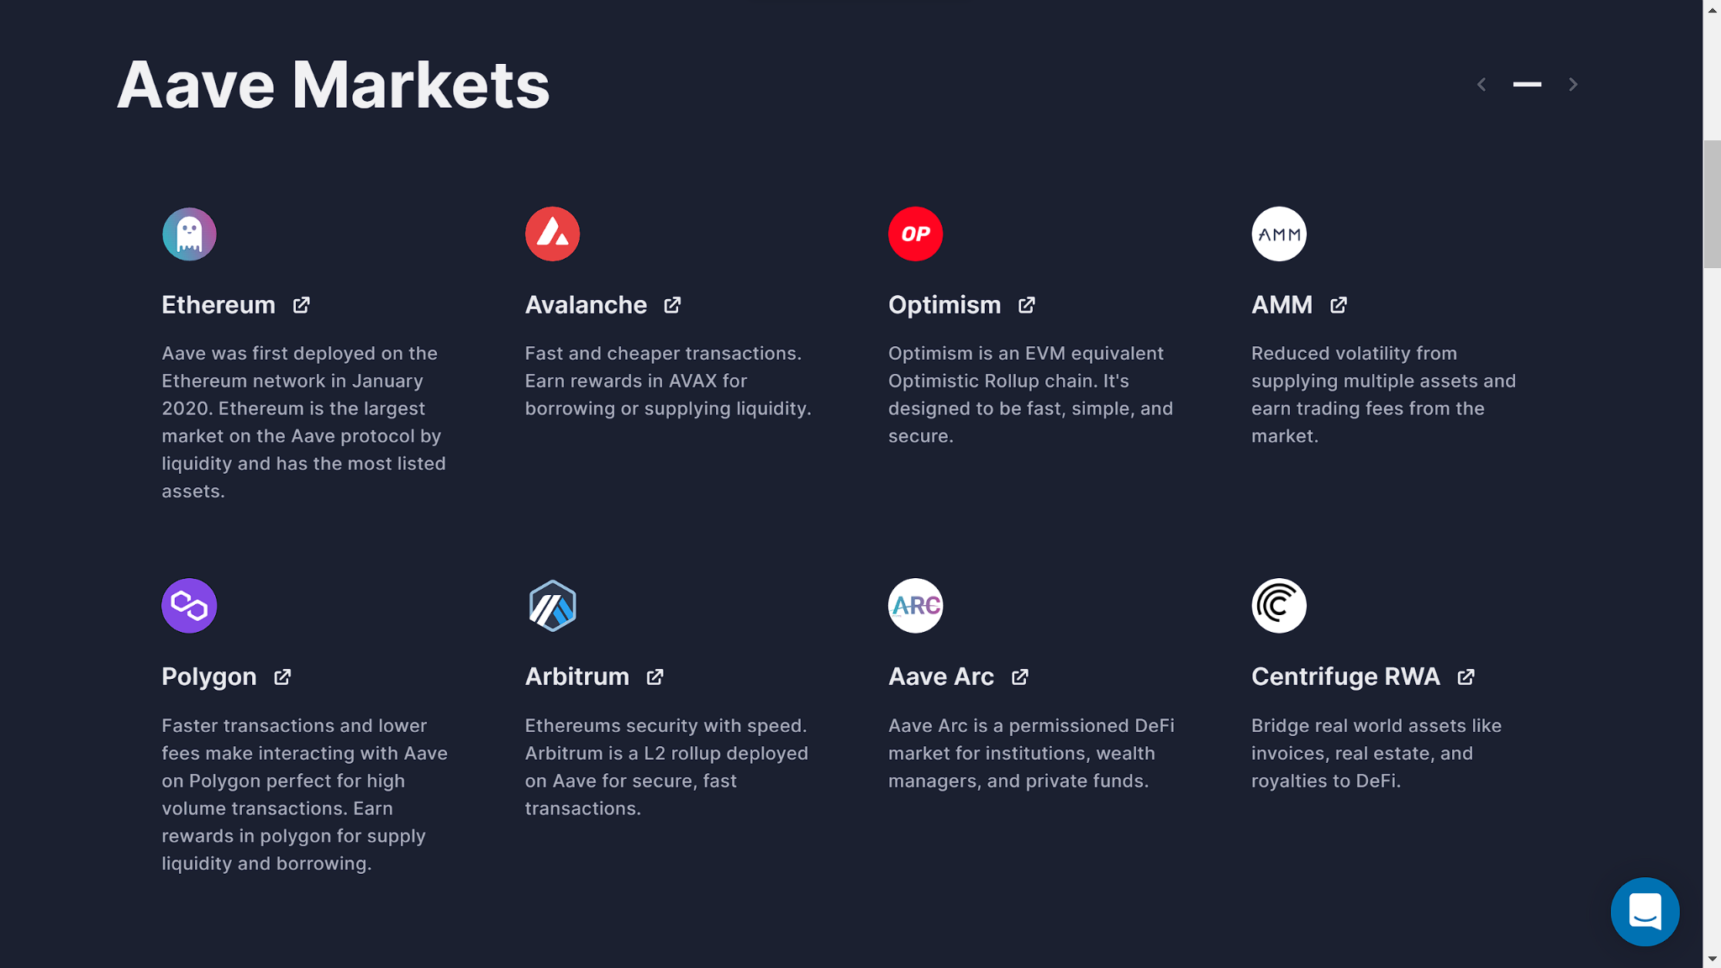
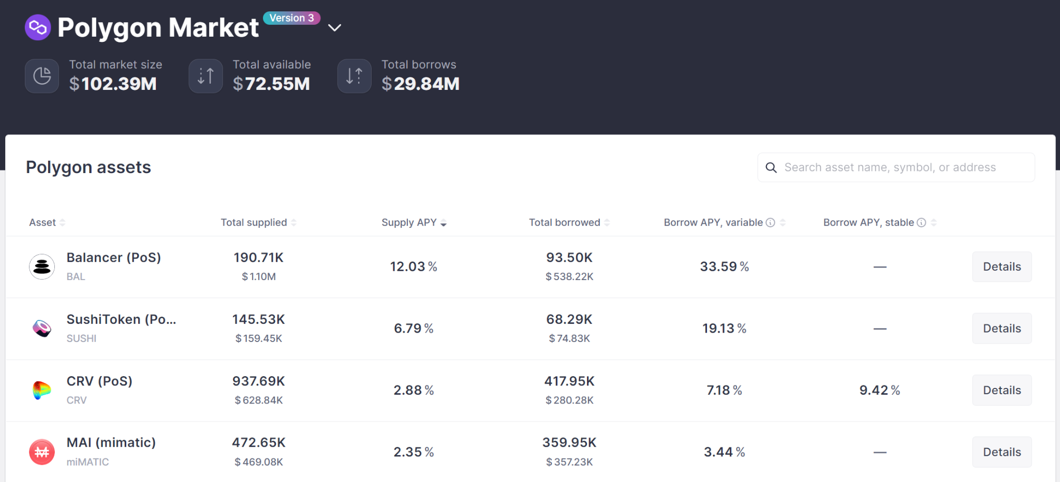
AAVE allows cross-chain Transfer

Slide 24
Flash Loans
These are short-term loan that can be taken out and repaid within the same Ethereum block, usually in a matter of seconds. These are Uncollateralized.
Flash loans are used primarily in the decentralized finance (DeFi) ecosystem to perform a number of different activities, such as: Arbitrage: borrowing an asset at a lower price on one exchange and then lending it out at a higher price on another exchange, making a profit on the spread. AAVE charges 0.09% as fee.
Flash loan attack: The possibility to borrow large amounts of money without collateral, and then use it to drain or manipulate pools

Slide 25
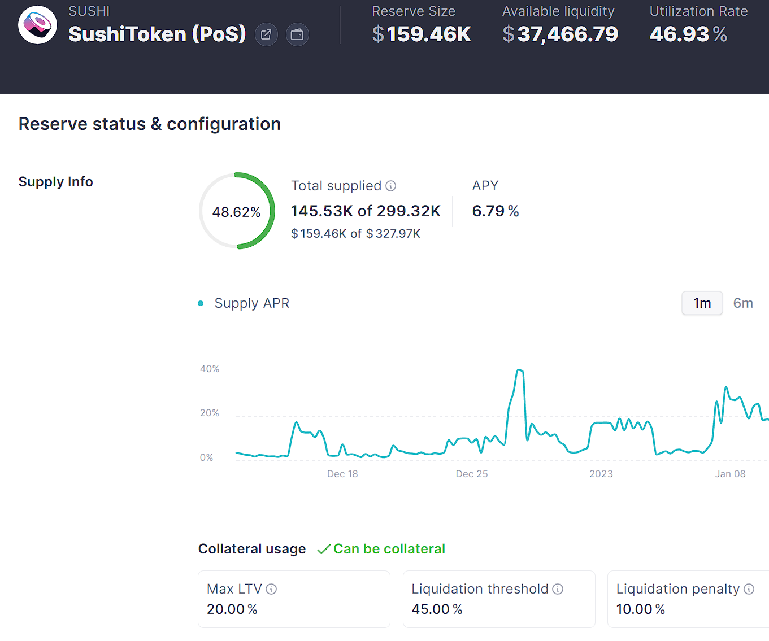
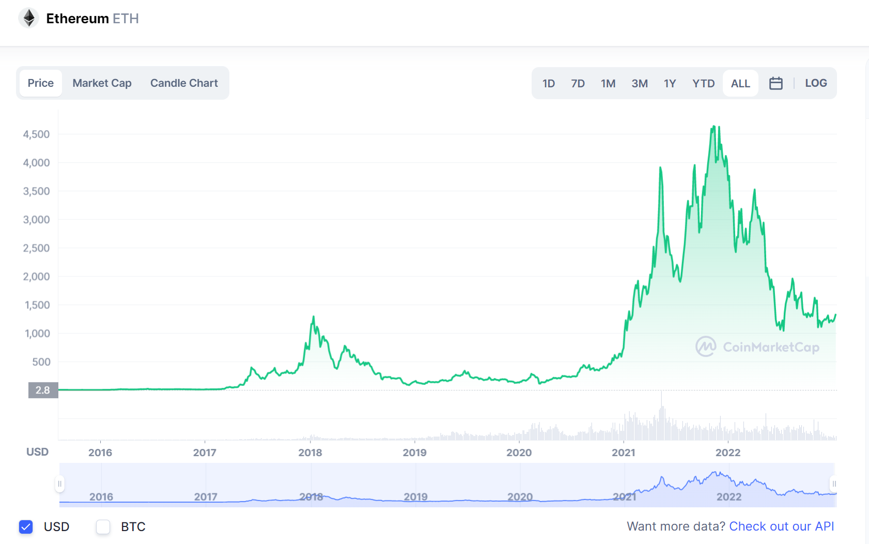
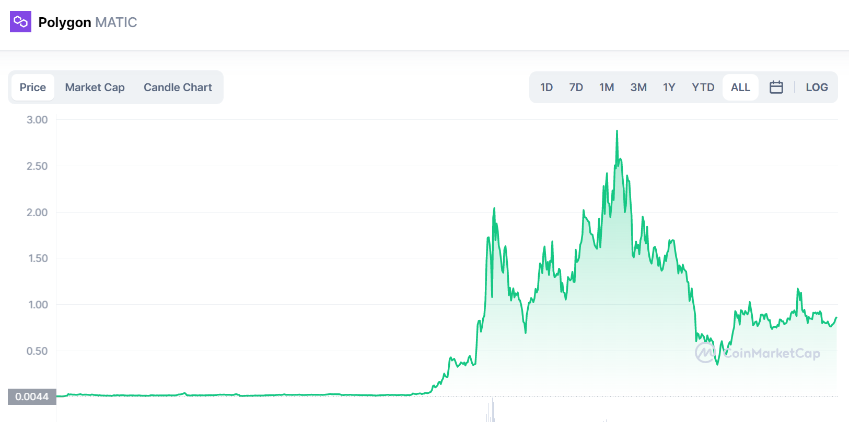
Risks of using Aave
Blockchain Risk : Smaller networks may get hacked
Liquidation Risk
Asset Risk

Slide 26
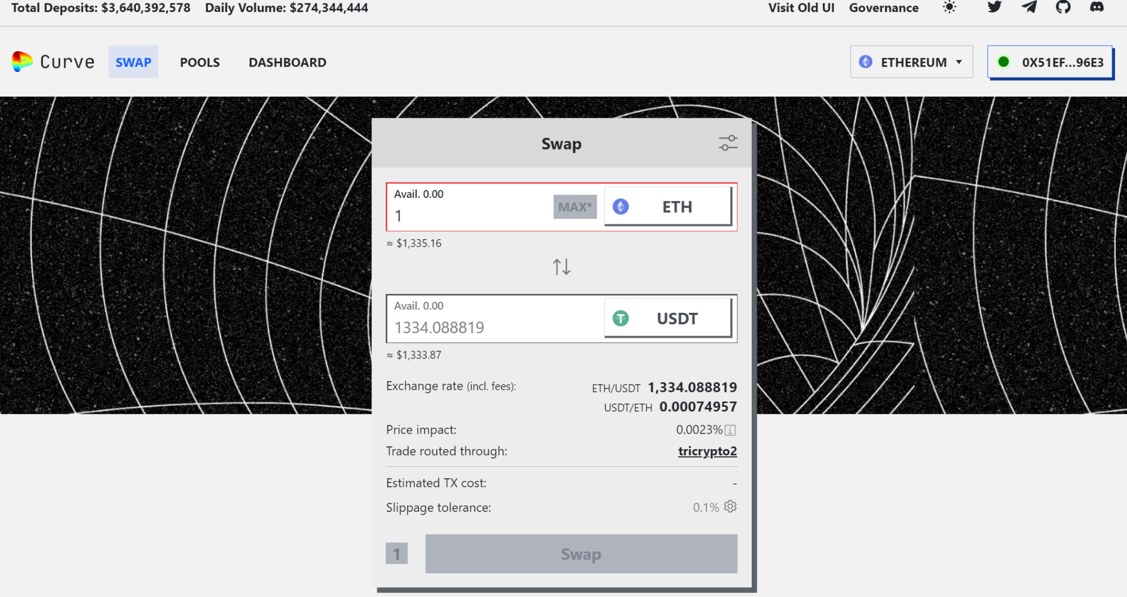
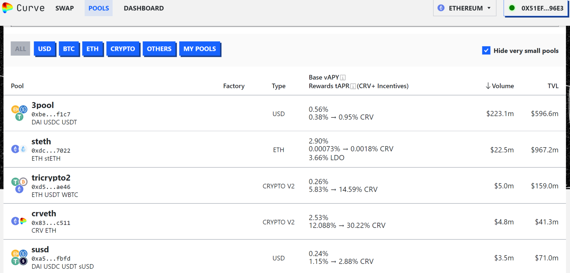
2. Automated Market Making : Curve Finance
A Decentralized Exchange(DEX) running on Ethereum, that allow users to trade cryptos with minimal slippage. Curve's liquidity pools are composed of multiple stablecoins, and the platform's smart contract automatically executes trades between these stablecoins in a way that minimizes price slippage. By pooling together multiple stablecoins, Curve aims to provide a stable trading environment and reduce the volatility. CRV is the native token. We will be able to earn returns in CRV by providing liquidity to liquidity pools and through transaction fees.

Slide 27
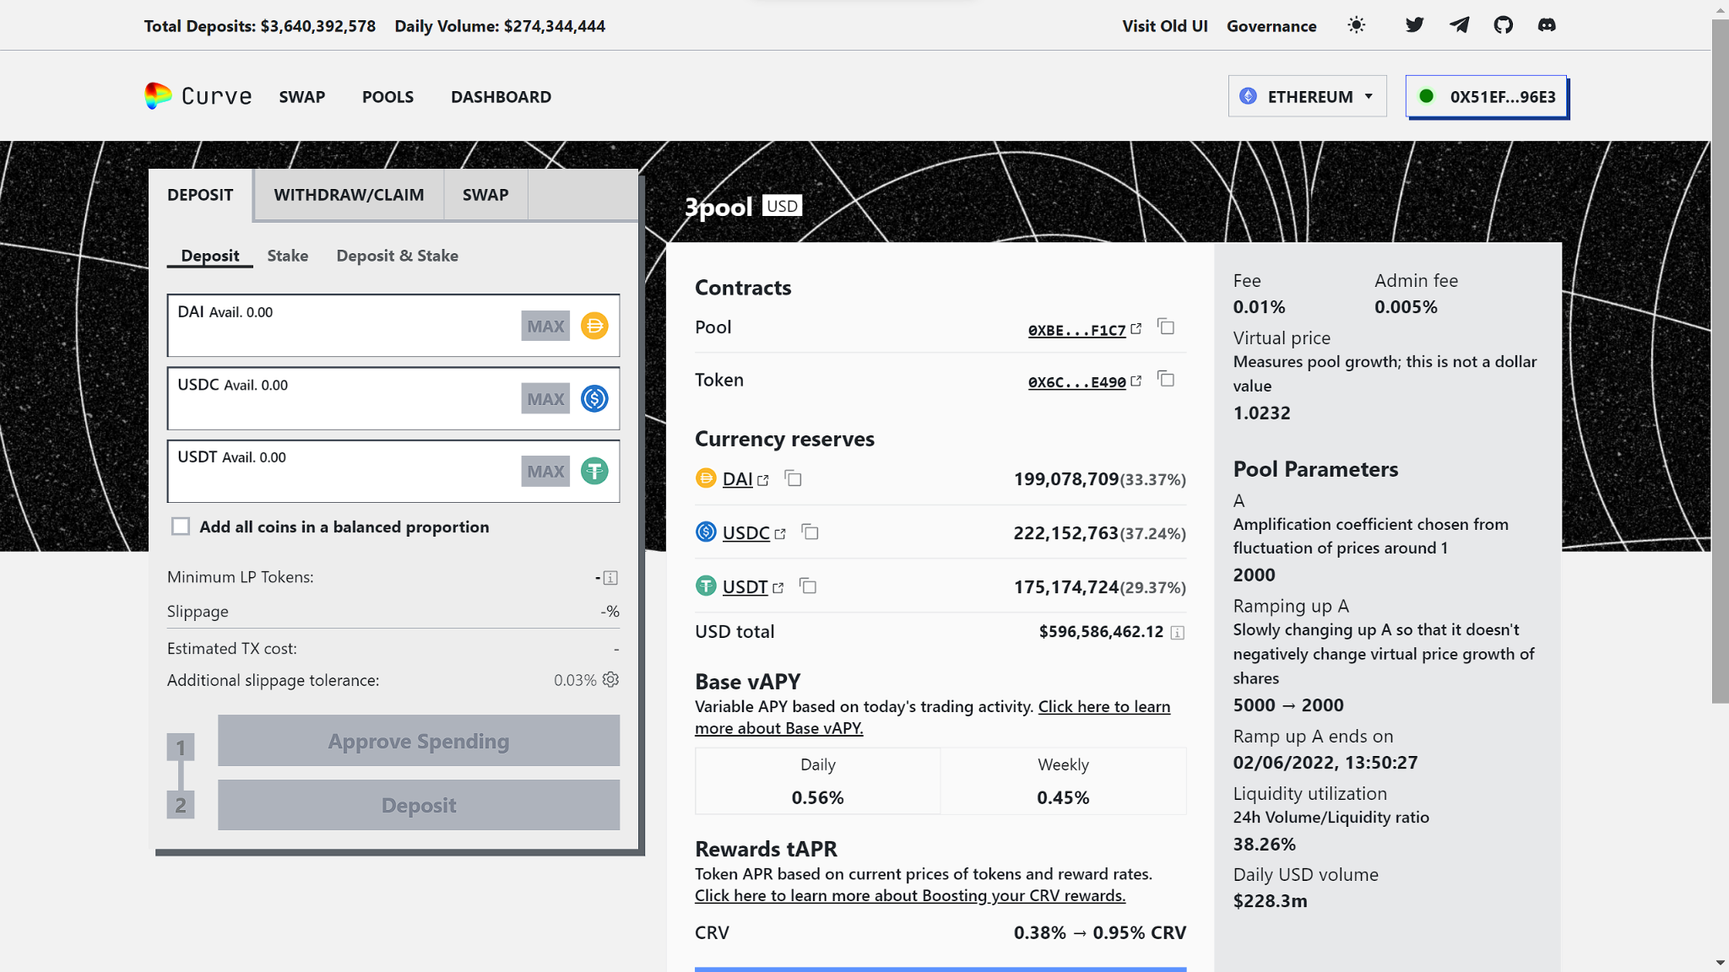
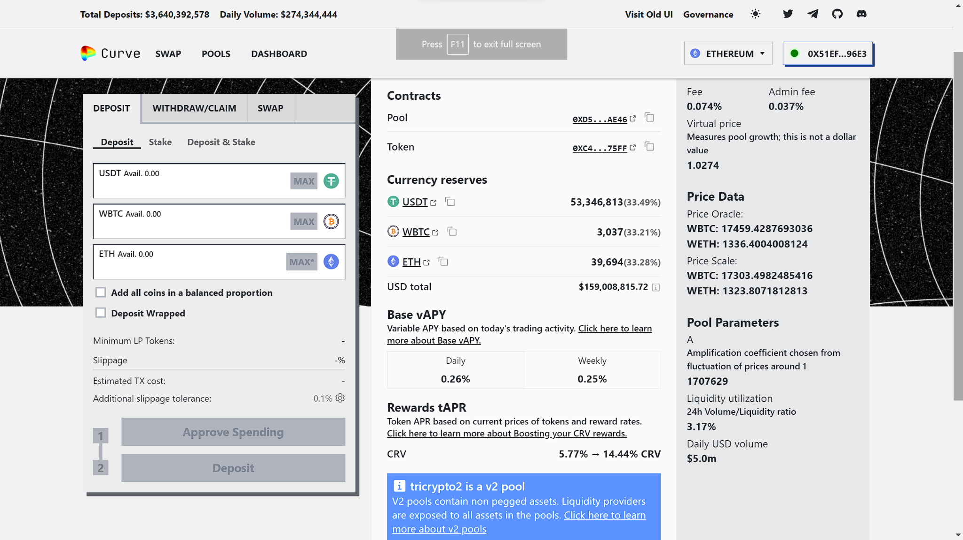
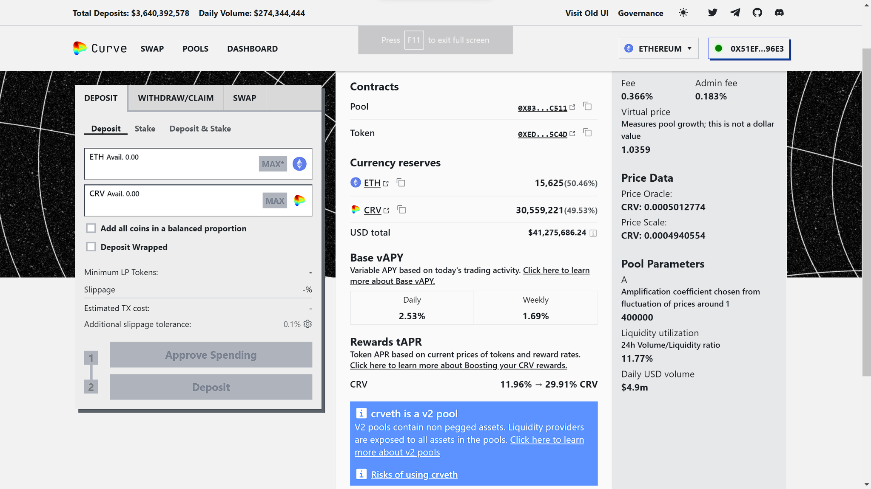

Slide 28
Risks
Impermanent loss : AMMs constantly adjust the prices of assets based on supply and demand, there is a risk that the value of an asset may change dramatically if one of the assets in the liquidity pool loses value.
Price slippage : AMMs rely on a mathematical formula to calculate prices, there can be a significant difference between the expected price of an asset and the actual price at which it trades.
Liquidity risk : AMMs rely on liquidity providers to supply assets to the liquidity pools. If there is a sudden withdrawal of liquidity, it can cause the price of an asset to change dramatically.

Slide 29
03
Yield Farming Strategies

Slide 30
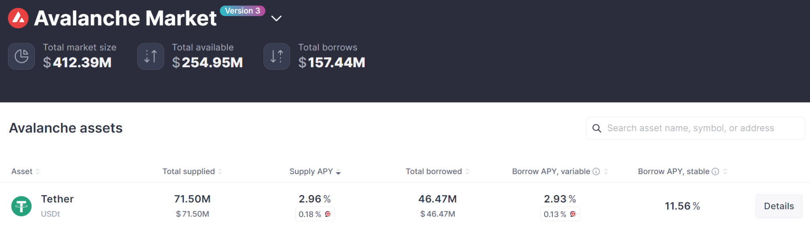
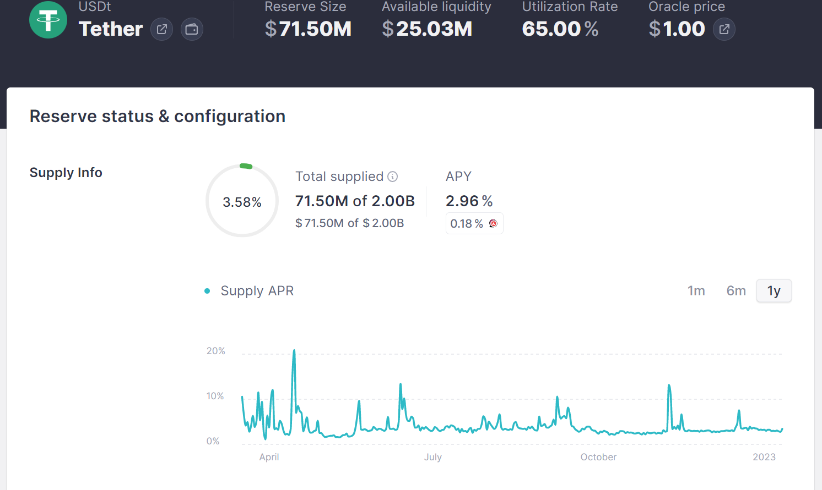
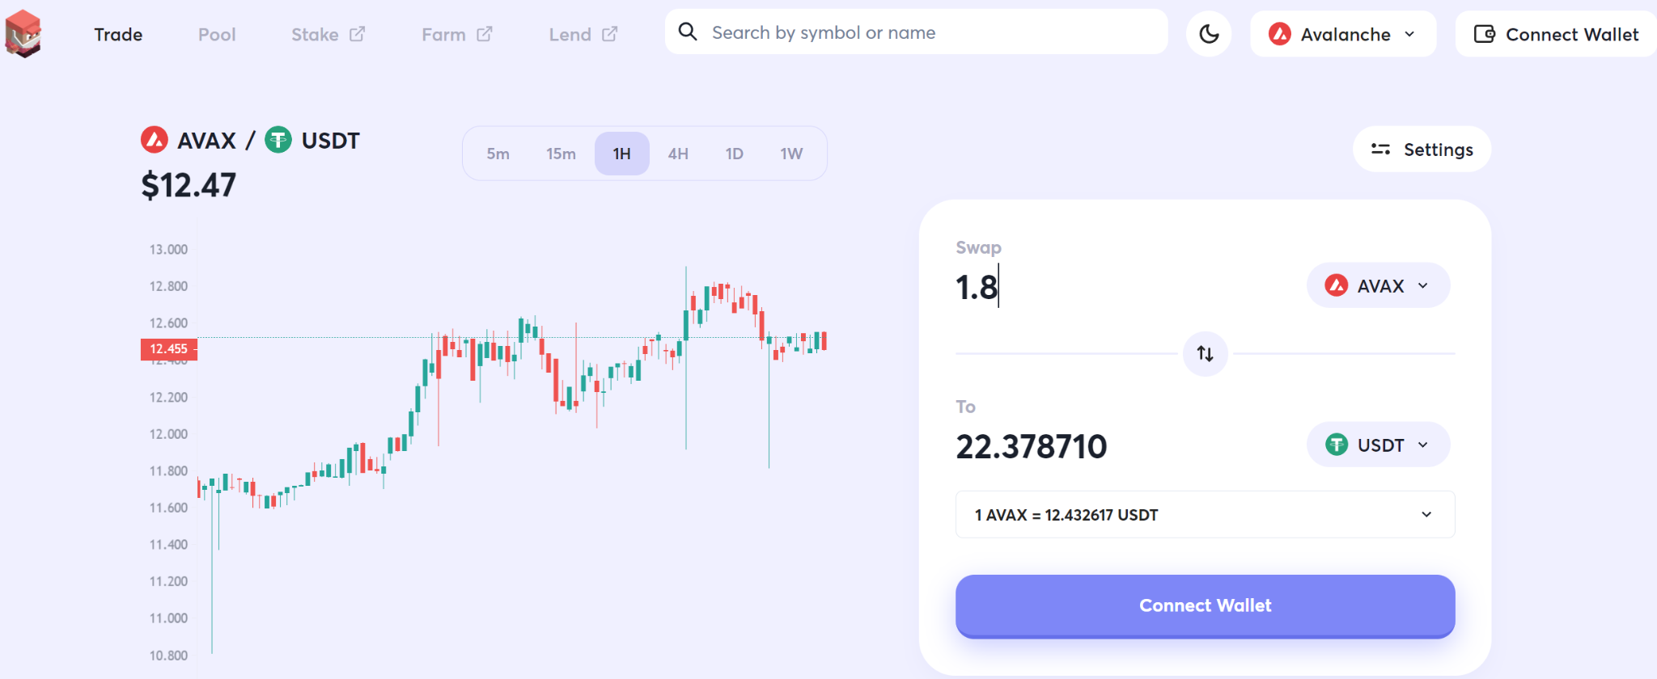
Lending Farming

Slide 31
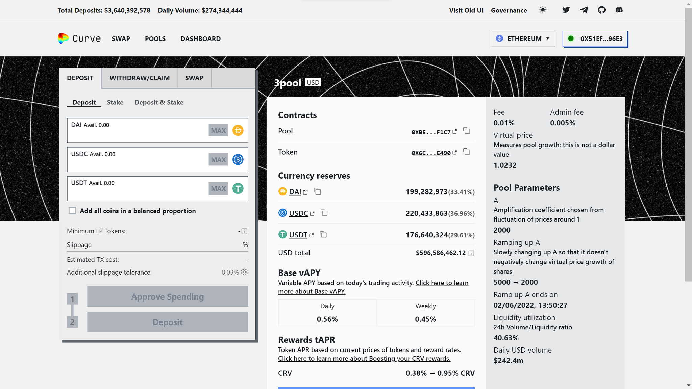

2. Liquidity Provider

Slide 32

Yield aggregators
Yield Aggregators automate the process of earning yields by automatically switching and shifting funds between different lending protocols, pools and platforms to find the highest interest rate at any given time.
Benefits of using Yield Aggregators are : Ease of use, Automation, High Yield, Diversification, Compounding Effect.

Slide 33



BEEFY FINANCE
Vaults in BEEFY :
Vaults are investment instruments that employ a specific set of strategies for yield farming. Vaults charge 0.1% fees on withdrawal amounts and a 4.0% performance fee

Slide 34






Slide 35




Yearn FInance
It offers multitude of products, lending aggregator, yearn vaults and so. Vaults charge a 10% performance fee and a 2% management fee. Performance fees are split 50:50 between the Treasury and the Strategist, the official creator of the strategy. The management fee is assigned fully to the Treasury

Slide 36

Risks of using Yield Aggregators
Traditionally, high rewards come with high risk and this is no different with yield farming.
Smart Contract Risk: Yield aggregators are built on top of smart contracts, which are self-executing computer programs. If there is a bug in the code or the smart contract is not properly audited, it could result in the loss of funds.
Liquidation Risk
Yield farming projects can be a very high-risk, high-reward venture, and their underlying assets are often extremely volatile.
APY instability: Market forces can lead to instabilities in the returns, making the advertised APYs unreliable.

Slide 37
References
https://defillama.com/
https://academy.binance.com/en/articles/what-is-yield-farming-in-decentralized-finance-defi
https://cointelegraph.com/defi-101/what-are-defi-yield-aggregators-and-how-do-they-work
https://opengeekslab.com/blog/yield-farming-defi/
https://app.harvest.finance/
https://yearn.finance/vaults
https://traderjoexyz.com/trade
https://curve.fi/#/ethereum/swap
https://app.aave.com/
https://www.investopedia.com/decentralized-finance-defi-5113835
https://www.coinbase.com/learn/crypto-basics/what-is-defi
https://cointelegraph.com/defi-101/defi-a-comprehensive-guide-to-decentralized-finance
https://ethereum.org/en/defi/
https://s-pro.io/blog/what-is-defi
https://defillama.com/

Slide 38
References
https://www.thebalancemoney.com/what-is-yield-farming-in-cryptocurrency-5272063#:~:text=Definition,that%20generates%20interest%20in%20return.
https://coinmarketcap.com/alexandria/article/what-is-yield-farming
https://opengeekslab.com/blog/yield-farming-defi/
https://farm.xyz/whitepaper/
https://academy.binance.com/en/articles/what-is-yield-farming-in-decentralized-finance-defi
https://cointelegraph.com/defi-101/defi-a-comprehensive-guide-to-decentralized-finance
https://cointelegraph.com/defi-101/the-defi-stack-stablecoins-exchanges-synthetics-money-markets-and-insurance
https://www.coingecko.com/learn/what-is-apy-apr-and-impermanent-loss

